Slide 1
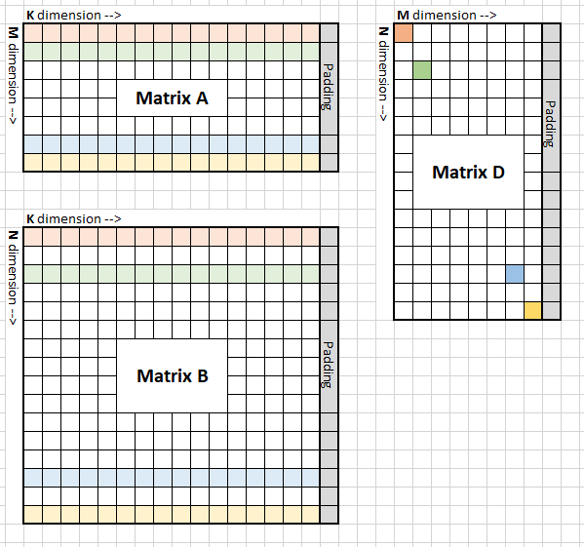
Auto generator
Example :
Data type: bf16
Gemm format: column major
Gemm size: M = 960, N = 1024, K = 1024
Padding: 32DWORD
Mfma per wave: 1 * 2
Wave per group: 2 * 2
MT size: 64 * 128

Slide 2
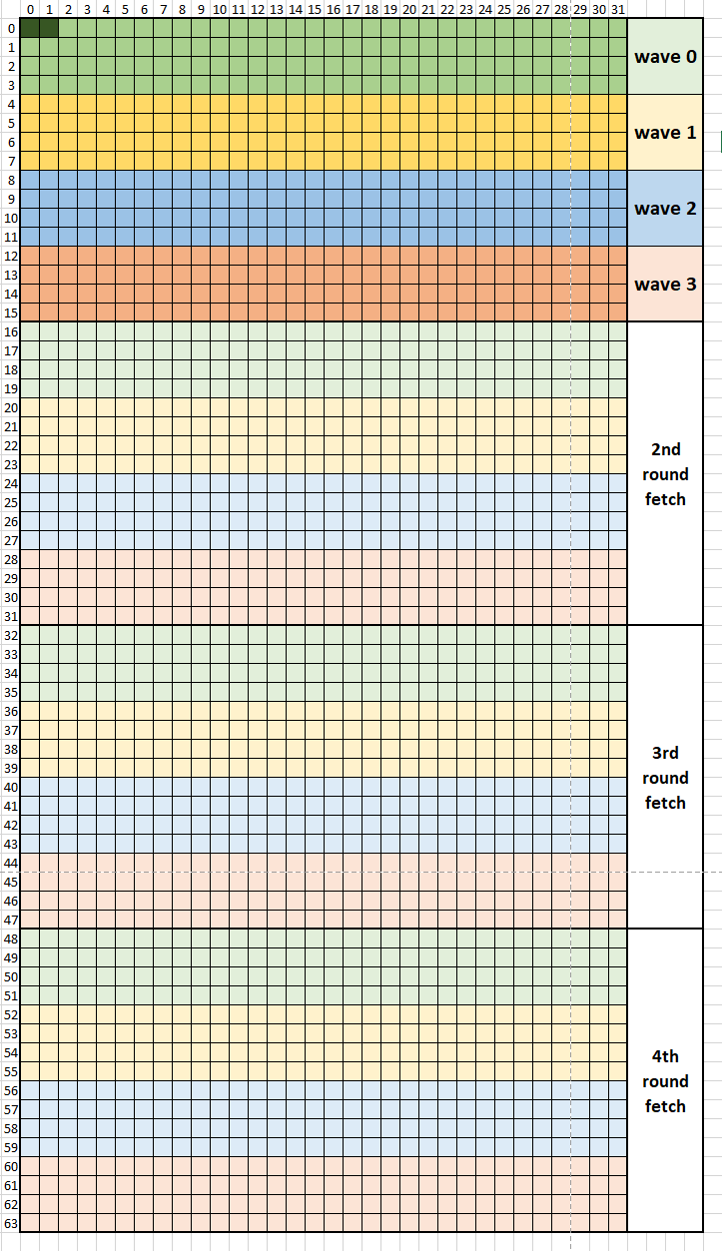
Auto generator
Global fetch work load:
Fetcht instruction width:
1DWORD = 2 element
Fetch amount:
A: DepthU * MT0 = 32 * 64 elements
B: DepthU * MT1 = 32 * 128 elements
Fetch amount per wave:
DepthU * 4 = 32 * 4 elements
Fetch amount per round:
DepthU * 4 * wave_num = 32 * 16 elements
Fetch rounds:
A: MT0 / (4* wave_num) = 4
B: MT1 / (4* wave_num) = 8

Slide 3
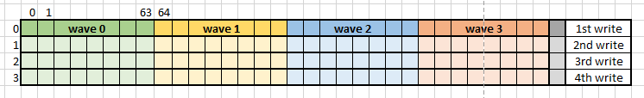
Auto generator
LDS storage :
Lds buffer size:
A: depthU * MT0 * ele_sz = 32 * 64 * 2 = 4KB
B: depthU * MT1 * ele_sz = 32 * 128 * 2 = 8KB
Total LDS size = (A+B) * 2 = 32KB
Lds write instruction size: 2 elements = 4Byte
Lds write per round: 32 * 16 elements = 1KB
Lds write rounds: 4 rounds for A; 8 round for B

Slide 4
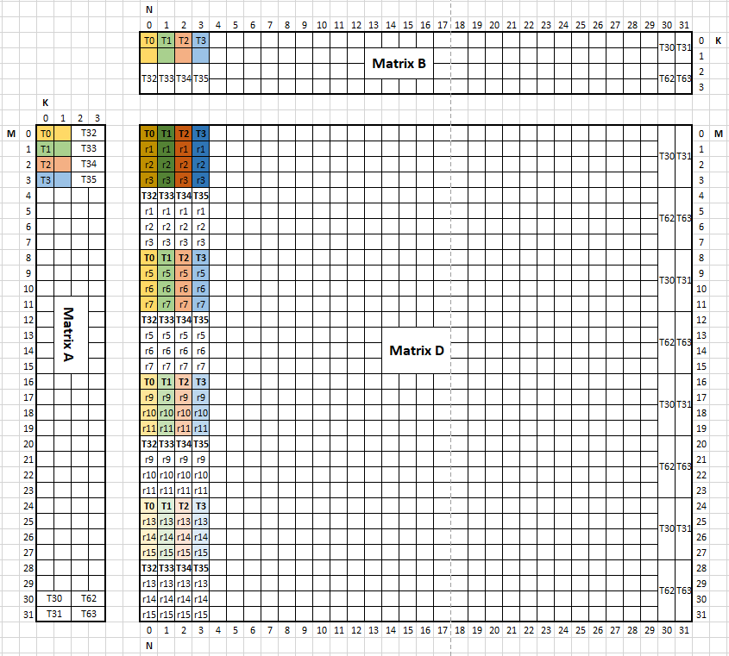
Auto generator
mfma:
Matrix A
M * K = 31 * 4
Every thread hold 2 elements in K dim
Matrix B
N * K = 31 * 4
Every thread hold 2 elements in Kdim
Matrix D
M * N = 31 * 31
Every thread hold 4 lane in M dim
Every lane has 4 elements in M dim

Slide 5
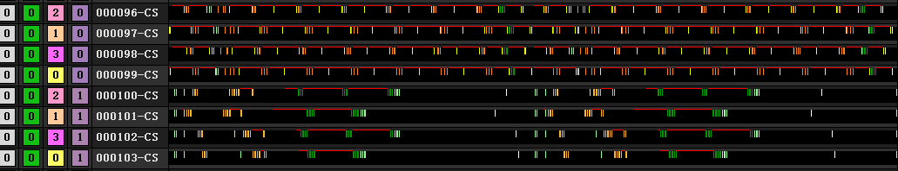
Auto generator
2 wave iteration
Fetch finish
Math finish
barrier
Thread trace for 2 buffers

